Slide 1

23AID302 - Big Data Analytics
Project Title: Skin Cancer Detection using SCALA
Team: A17
TEAM MEMEBERS:
Dheeraj Doma(CB.AI.U4AID23007)
Kota Kedhar nadh(CB.AI.U4AID23015)
M Sai Krishna(CB.AI.U4AID23020)
Molakalapalli Rishitha(CB.AI.U4AID23023)
Department: AIDS
Faculty In-charge: Dr. Sreeja
College, Academic Year: Amrita Vishwa Vidyapeetham, 2025

Slide 2
Introduction / Background
The rising global incidence of skin cancer, particularly melanoma, has created an urgent need for advanced detection tools. Traditional methods like dermatoscopy, despite being non-invasive, suffer from subjective interpretation and diagnostic variability. This motivated the adoption of computer-aided diagnosis systems, aiming to add objectivity and scalability to clinical decision-making through quantitative, reproducible analysis of skin lesions using large-scale medical datasets and machine learning approaches

Slide 3
Problem Statement
Manual analysis of dermatoscopic images is subjective and often leads to inconsistent diagnostic accuracy and unnecessary biopsies. There is a critical need for a scalable, automated system that can process large volumes of skin lesion images efficiently and aid clinicians in making accurate, timely diagnoses.

Slide 4
Objectives
To build a scalable system for automated skin cancer detection.
To leverage big data technologies (e.g., Apache Spark) for efficient processing of large medical image datasets.
To design a feature engineering pipeline for extracting medically relevant features.
To compare and select optimal machine learning models for image-based classification.
To demonstrate system robustness, scalability, and accuracy in a real-world scenario.

Slide 5
Literature Review
SI NO | Paper Title / Focus | Authors | Year | Key Contributions / Findings
1 | Deep Learning Outperformed Pathologists in Melanoma Classification | Achim Hekler et al. | 2019 | CNN trained on 595 histopathological images achieved 76.6% sensitivity, 68% specificity, 69% accuracy; outperformed 11 pathologists
2 | Classification Optimization of Skin Cancer Using the Adaboost Algorithm | Sumiyatun, Andi Maulidinnawati | 2023 | Used Canny edge detection, Hu Moments, AdaBoost on 10,000 images; achieved 61.52% accuracy; highlighted classification challenges
3 | Medical Scanning Device for Early Detection of Skin Cancer | Shereen Afifi et al. | 2025 | Embedded diagnostic device (ResNet50 on Raspberry Pi 3), achieved 78% accuracy; demonstrated real-time application
4 | Skin Cancer Predictor Using Big Data Techniques | P. Subhashini Peneti et al. | 2021 | Economical, big data-based system; achieved 70% accuracy; enabled remote meta-report and diagnosis generation
5 | Comparison of KNN and SVM Methods for Melanoma Classification | Catalina Camargo et al. | 2024 | Compared KNN and SVM with Otsu segmentation and features; KNN: 58.96% accuracy, SVM: 64.09%
6 | Novel End-to-End Deep Learning for Skin Cancer (Web App) | Mejdal A. Alqahtani | 2024 | DenseNet121 model achieved 98% training accuracy, 82% validation, 78% test; outperformed ensembles and vanilla CNNs
7 | Skin Cancer Detection Review Using ML Techniques | Pooja Shinde, Yashwant Ingle | 2024 | Compared SVM, VGG16/19, Inception, Xception, CNN on 30k images; CNN performed best (74%); highlighted ML potential

Slide 6
Dataset Description
The dataset consists of dermatoscopic images of skin lesions, collected for the purpose of automated skin cancer detection and classification.
Each sample typically includes:
  Original image: High-resolution photograph of a skin lesion region.
  Mask image (Ground Truth): A corresponding binary mask where the lesion area is marked in white on a black background, used in segmentation tasks.
The images are categorized into:
  Benign: Non-cancerous lesions
  Malignant: Cancerous lesions
All images are stored in HDFS, separated into “benign” and “malignant” directories. Both original and mask files are present in each folder.

Slide 7
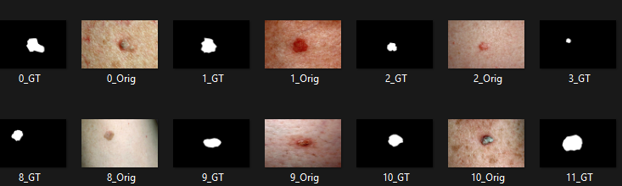
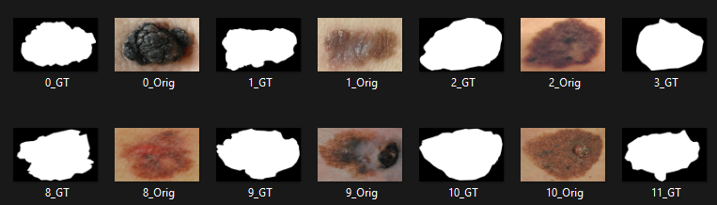
Dataset

Slide 8
Methodology
Data Acquisition: Images are ingested from structured directories (Benign/Malignant subfolders).
Parallel Data Loading: High-performance, fault-tolerant image loading using Spark, with synthetic dataset fallback for development/debugging.
Feature Engineering: Extraction of 80 medically inspired features (color, texture, asymmetry, edge gradients, etc.).

Slide 9
Methodology
Model Training: Class balancing and comparative evaluation of Random Forest, Gradient-Boosted Trees, SVM, and Logistic Regression; hyperparameters tuned for accuracy and robustness.
System Architecture: Web application frontend (Play Framework), Spark backend for big data processing, Spark MLlib for distributed machine learning.

Slide 10
Implementation Details
Technologies Used: Apache Spark, Play Framework (Scala), Spark SQL, MLlib, JVM 8+.
Hardware Requirements: Multi-core CPU (4+ cores), 16GB RAM, sufficient disk storage.
Software Architecture: Parallel data preprocessing with Spark RDDs, distributed ML training using DataFrames, integrated user-facing frontend for image submission and result visualization

Slide 11
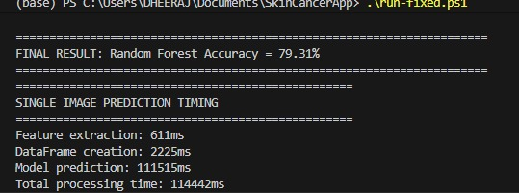
Results & Analysis
Model | Accuracy (%)
Random Forest | 79.31
Gradient-Boosted Trees | 72.45
Logistic Regression | 68.12
Support Vector Machine | 66.89

Slide 12
Results

Slide 13
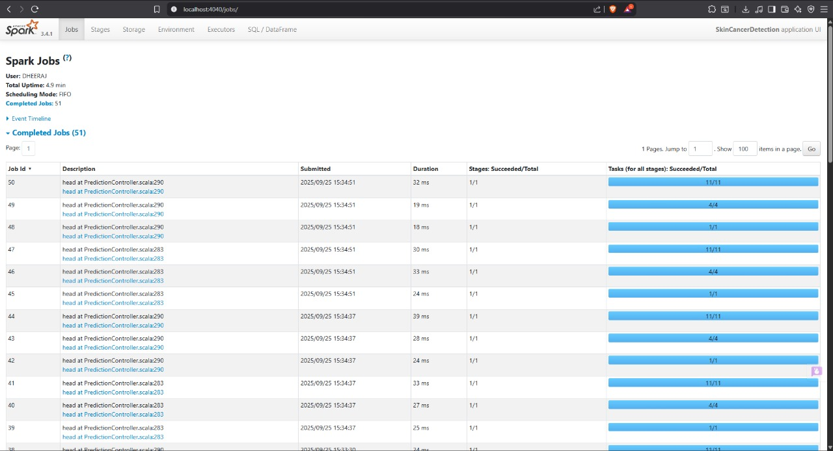
Results

Slide 14
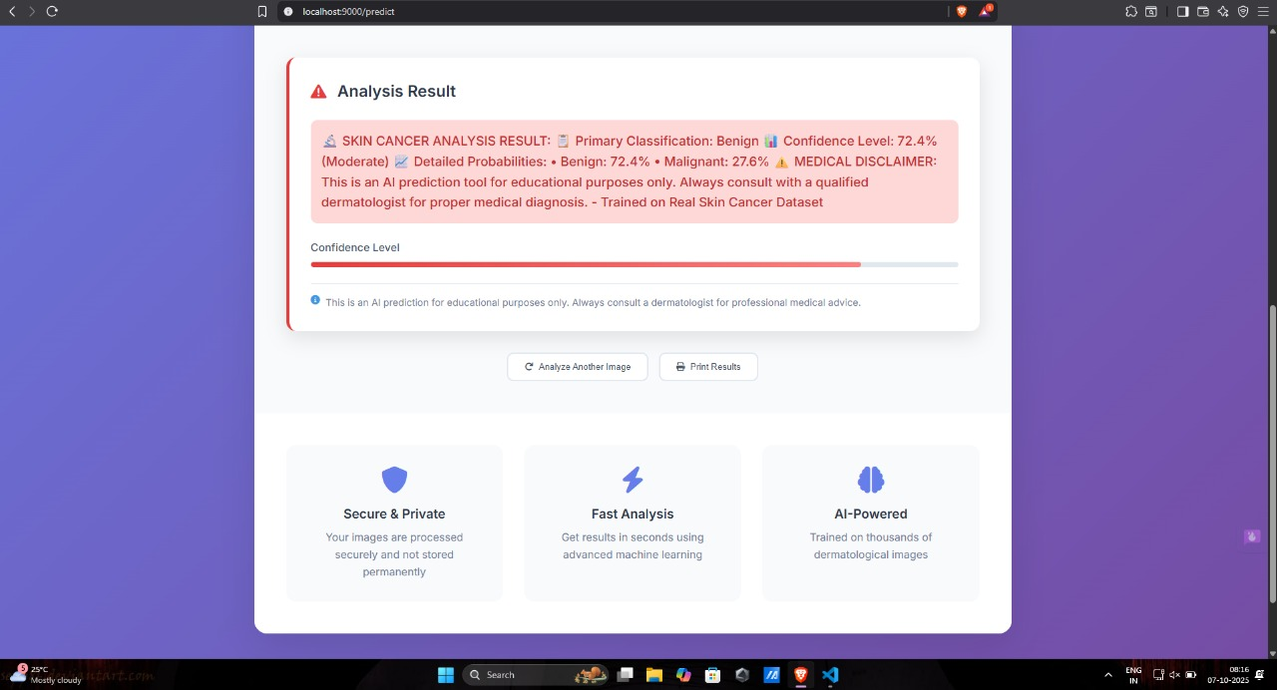
Results: UI

Slide 15
Challenges / Limitations
Processing bottlenecks are common with traditional, sequential pipelines and large medical images.
Initial model training and system initialization are resource-intensive.
Clinical applications require extensive validation and regulatory approval before deployment

Slide 16
Impact Comparison Between Big Data Tools and Conventional Data Processing Techniques
Conventional Techniques: Slow, sequential, not suited for dynamic/large datasets; limit experimentation and real-time deployment.
Big Data Tools (e.g., Apache Spark): Enable parallel processing, efficient data pipeline scaling, and agile iteration over massive datasets. Essential for building next-generation, real-time, and scalable clinical decision support solutions. Demonstrated near-linear speedup and robust, fault-tolerant data ingestion

Slide 17
Conclusion & Future Work
Conclusion: Successfully built and validated a scalable, big data-driven system for skin cancer detection with state-of-the-art accuracy and performance.
Future Work: Integrate deep learning (CNNs), deploy on multi-node Spark clusters for further scalability, and implement persistent model storage to reduce downtime.

Slide 18
References
Achim Hekler et al., "Deep learning outperformed 11 pathologists in the classification of histopathological melanoma images", 2019.
Sumiyatun, Andi Maulidinnawati, "Classification Optimization of Skin Cancer Using the Adaboost Algorithm", 2023.
Shereen Afifi et al., "A Medical Scanning Device for Early Detection of Skin Cancer", 2025.
P. Subhashini Peneti et al., "Skin Cancer Predictor by Image Processing using Big Data Techniques", 2021.
Catalina Camargo et al., "Comparison of KNN and SVM Methods for Melanoma Classification", 2024.
Mejdal A. Alqahtani, "A Novel End-to-End Deep Learning Approach for Skin Cancer Detection Based on Web Application", 2024.
Pooja Shinde, Yashwant Ingle, "Skin Cancer Detection: A Review Using Machine Learning Techniques", 2024.

